Slide 1
Unusually Formal Method: a Verilog program verifier
Sophia Zhang

Slide 2
INTRODUCTION: HDLs
Hardware Description Language: language used to describe digital logic circuits
Gate level and higher-level abstractions
For simple and complex designs
module adder(a, b, out);
input [1:0] a, b;
output [1:0] cout;
assign cout = a + b;
endmodule
module adder(a0, a1, b0, b1,
cout0, cout1);
input a0, a1, b0, b1;
output cout0, cout1;
assign cout0 = a0 ^ b0;
assign cout1 = (a1 ^ b1) ^ (a0 & b0);
endmodule

Slide 3
INTRODUCTION: Verification
Pre-silicon testing
Unit tests through UVM
Coverage tests
Profiling
Formal methods like model checking

Slide 4

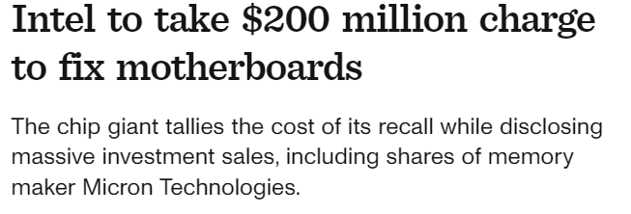


Motivation

Slide 5
Motivation
Writing unit and coverage tests
Lots of programming effort
May not cover all test cases!
Formal verification
Model checking and program abstraction
Lots of programmer effort + knowledge needed
Lots of resources + time

Slide 6
Project Goals
A program verifier similar to Dafny
Supports formal verification through annotated post conditions within the Verilog language
Supports formal verification of bit-level combinational logic
Outputs only involve the inputs no concept of state

Slide 7
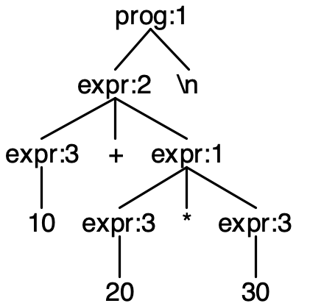




Implementation
Verilog.g4
mkAdd(10, mkMul(20,30))
…
10+20*30
#ensures(10+20*30==610)
Language Parser
Custom Z3 Boolean Converter
Source code
Syntax Tree
Z3 equivalent
Notes:
Mention was unable to find a suitable Verilog parser so had to somewhat implement own

Slide 8
Example: 2-Bit adder
module adder(a0, a1, b0, b1,
cout0, cout1);
input a0, a1, b0, b1;
output cout0, cout1;
assign cout0 = a0 ^ b0;
assign cout1 = (a1 ^ b1) ^ (a0 & b0);
//@ensures cout0 == a0 ^ b0 endmodule

Slide 9
Example: 2-Bit adder
from z3 import *
a0 ,a1 ,b0 ,b1 = Bools('a0 a1 b0 b1')
cout0 ,cout1 = Bools('cout0 cout1')
cout0 = Xor((a0),(b0),)
cout1 = Xor((Xor((a1),(b1),)),(And((a0),(b0),)),)
ensures = Not(cout0==Xor((a0),(b0)))
s = Solver()
s.add(cout0)
s.add(cout1)
s.add(ensures)
if s.check() == sat:
m = s.model()
print("found a counter example!")
else:
print("UNSAT so satisfied")
from z3 import *
a0 ,a1 ,b0 ,b1 = Bools('a0 a1 b0 b1')
cout0 ,cout1 = Bools('cout0 cout1')
cout0 = Xor((a0),(b0),)
cout1 = Xor((Xor((a1),(b1),)),(And((a0),(b0),)),)

Slide 10

Example: 2-Bit adder
from z3 import *
a0 ,a1 ,b0 ,b1 = Bools('a0 a1 b0 b1')
cout0 ,cout1 = Bools('cout0 cout1')
cout0 = Xor((a0),(b0),)
cout1 = Xor((Xor((a1),(b1),)),(And((a0),(b0),)),)
ensures = Not(cout0==Xor((a0),(b0)))
s = Solver()
s.add(cout0)
s.add(cout1)
s.add(ensures)
if s.check() == sat:
m = s.model()
print("SAT, exists a counterexample!")
else:
print("UNSAT so satisfied")
module adder(a0, a1, b0, b1,
cout0, cout1);
input a0, a1, b0, b1;
output cout0, cout1;
assign cout0 = a0 ^ b0;
assign cout1 = (a1 ^ b1) ^ (a0 & b0);
//@ensures cout0 == a0 ^ b0 endmodule
$python adder_v1.v.py
UNSAT so satisfied

Slide 11

Example: 2-Bit adder
from z3 import *
a0 ,a1 ,b0 ,b1 = Bools('a0 a1 b0 b1')
cout0 ,cout1 = Bools('cout0 cout1')
cout0 = And((a0),(b0),)
cout1 = Xor((Xor((a1),(b1),)),(And((a0),(b0),)),)
ensures = Not(cout0==Xor((a0),(b0)))
s = Solver()
s.add(cout0)
s.add(cout1)
s.add(ensures)
if s.check() == sat:
m = s.model()
print(“SAT, exists a counterexample!")
else:
print("UNSAT so satisfied")
module adder(a0, a1, b0, b1,
cout0, cout1);
input a0, a1, b0, b1;
output cout0, cout1;
assign cout0 = a0 & b0;
assign cout1 = (a1 ^ b1) ^ (a0 & b0);
//@ensures cout0 == a0 ^ a1 endmodule
$ python adder_v1.v.py
SAT, exists a counterexample!

Slide 12
Next Steps
Must Accomplish
Future Directions
Automate the ensures clause in verification
Allow for multiple ensures
Expand beyond single bit abstraction
Expand to sequential logic
Expand the abstraction to beyond gate level

Slide 13
SUMMARY
UFM: Unusually formal method a formal program verifier for a subset of the Verilog language

